Slide 1
Chapter 2-2
Operations and Other Data Types
计算机系统概论
Introduction to Computing Systems
（CS1002A.02）
苗付友
mfy@ustc.edu.cn
2023 Fall
计算机科学与技术学院
School of Computer Science and Technology

Slide 2
Outline
1
Operations on Bits: Arithmetic and Logical
2
Other Representation
3
Summary

Slide 3
Outline
1
Operations on Bits: Arithmetic and Logical
2
Other Representation
3
Summary

Slide 4
Operations: Arithmetic and Logical
Recall: a data type includes representation and operations. We now have a good representation for signed integers, so let’s look at some arithmetic operations:
  Addition
  Subtraction
  Sign Extension
We’ll also look at overflow conditions for addition.
Multiplication, division, etc., can be built from these
basic operations.
Logical operations are also useful:
  AND
  OR
  NOT
Notes:
4

Slide 5
Addition
As we’ve discussed, 2’s comp. addition is just
binary addition.
  assume all integers have the same number of bits
  ignore carry out
  for now, assume that sum fits in n-bit 2’s comp. representation
01101000 (104) 11110110 (-10)
+ 11110000 (-16) + (-9)
01011000 (88) (-19)
Assuming 8-bit 2’s complement numbers.
Notes:
5
11110110 (-10)
11110111 (-9)
----------------------
11101101 (-19)
Check: {11101101} = 00010011 = 16 + 2 + 1 = 19, or
-128+64+32+8+4+1 = 19

Slide 6
Subtraction
Negate subtrahend (2nd no.) and add.
  assume all integers have the same number of bits
  ignore carry out
  for now, assume that difference fits in n-bit 2’s comp. representation
01101000 (104) 11110110 (-10)
- 00010000 (16) + (-9)
  01101000 (104) 11110110 (-10)
+ 11110000 (-16) + (9)
01011000 (88) (-1)
Assuming 8-bit 2’s complement numbers.
Notes:
6
11110110 (-10)
11110111 (-9)
----------------------
11101101 (-19)
11110110 (-10)
00001001 (9)
----------------------
11111111 (-1)

Slide 7
Sign Extension
4-bit 8-bit
0100 (4) 00000100 (still 4)
1100 (-4) 00001100 (12, not -4)
4-bit 8-bit
0100 (4) 00000100 (still 4)
1100 (-4) 11111100 (still -4)
To add two numbers, we must represent them
with the same number of bits.
If we just pad with zeroes on the left:
Instead, replicate the MS bit -- the sign bit:
Notes:
7

Slide 8
What if too big/small?
Integer and floating-point operations can lead to results too big/small to store within their representations: overflow/underflow
Binary bit patterns are simply representatives of
numbers. Abstraction!
  Strictly speaking they are called “numerals”.
Numerals really have an ∞ number of digits
However, a computer is equipped with register, memory unit of finite length (limited number of bits)
If result of add (or -, *, / ) cannot be represented by
these finite bits in a computer, we say overflow occurred

Slide 9
Overflow
If operands are too big, then sum cannot be represented as an n-bit 2’s comp number.
We have overflow if:
  signs of both operands are the same, and
  sign of sum is different.
Another test -- easy for hardware:
  carry into MS bit does not equal carry out
01000 (8) 11000 (-8)
+ 01001 (9) + 10111 (-9)
10001 (-15) 01111 (+15)
Notes:
9

Slide 10
Logical Operations
A | B | A AND B
0 | 0 | 0
0 | 1 | 0
1 | 0 | 0
1 | 1 | 1
A | B | A OR B
0 | 0 | 0
0 | 1 | 1
1 | 0 | 1
1 | 1 | 1
A | NOT A
0 | 1
1 | 0
Operations on logical TRUE or FALSE
  two states -- takes one bit to represent: TRUE=1, FALSE=0
View n-bit number as a collection of n logical values
  operation applied to each bit independently
Notes:
10

Slide 11
Examples of Logical Operations
11000101
AND 00001111
00000101
11000101
OR 00001111
11001111
NOT 11000101
00111010
AND
  useful for clearing bits
    AND with zero = 0
    AND with one = no change
OR
  useful for setting bits
    OR with zero = no change
    OR with one = 1
NOT
  unary operation -- one argument
  flips every bit
Notes:
11

Slide 12
Outline
1
Operations on Bits: Arithmetic and Logical
2
Other Representation
3
Summary

Slide 13
Fractions: Fixed-Point
n | 2^{n}
0 | 1
1 | 2
2 | 4
3 | 8
4 | 16
5 | 32
6 | 64
7 | 128
8 | 256
9 | 512
10 | 1024
2⁻¹ = 0.5
2⁻² = 0.25
2⁻³ = 0.125
00101000.101
+ 11111110.110
00100111.011
(40.625)
+ (-1.25)
(39.375)
No new operations -- same as integer arithmetic.
How can we represent fractions?
  Use a “binary point” to separate positive
  from negative powers of two -- just like “decimal point.”
  2’s comp addition and subtraction still work.
    if binary points are aligned
Notes:
13

Slide 14
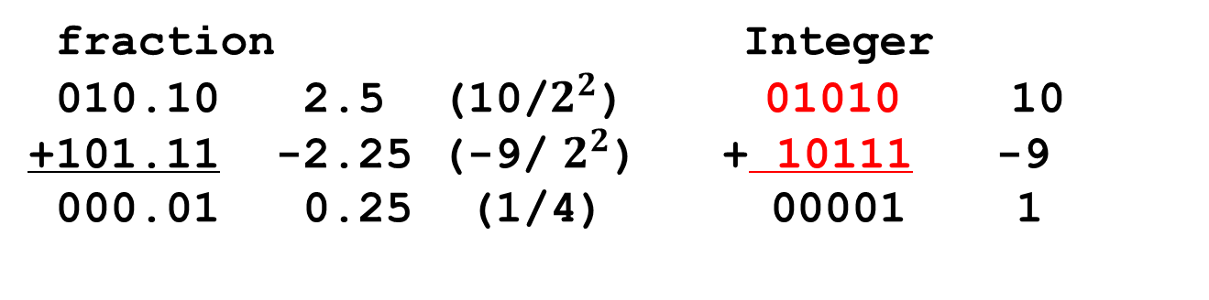
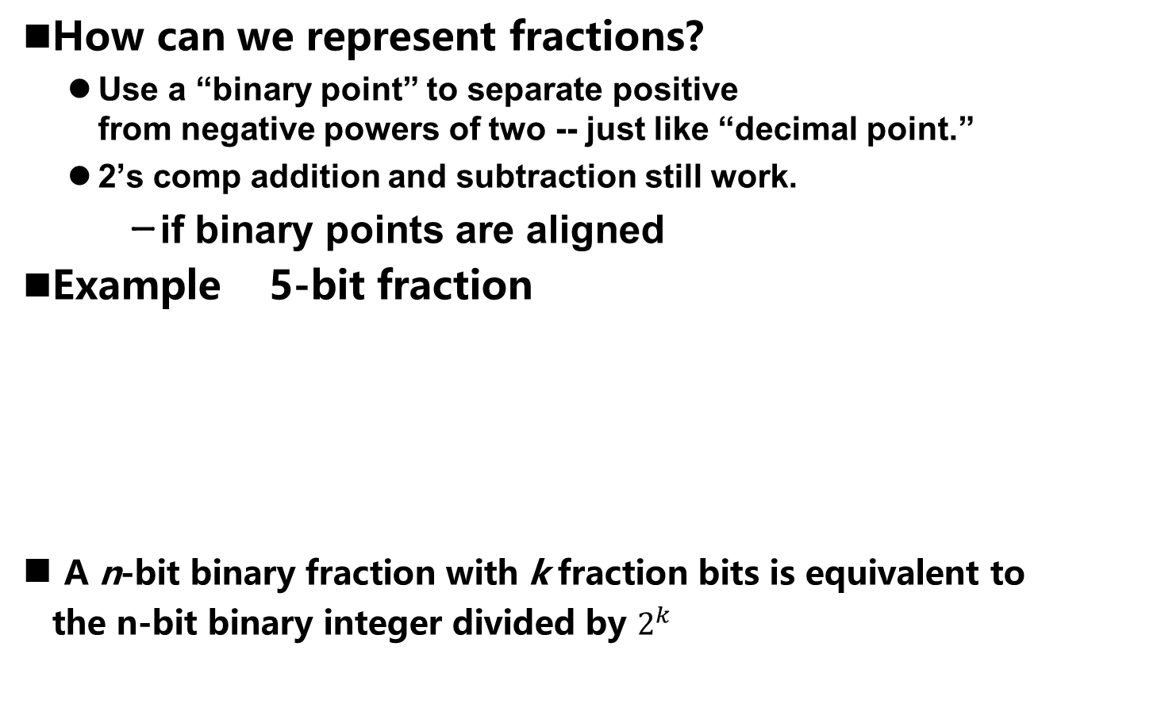
Fractions: Fixed-Point
How can we represent fractions?
  Use a “binary point” to separate positive
  from negative powers of two -- just like “decimal point.”
  2’s comp addition and subtraction still work.
    if binary points are aligned
Example 5-bit fraction
A n-bit binary fraction with k fraction bits is equivalent to
the n-bit binary integer divided by $2^{k}$
fraction Integer
010.10 2.5 (10/$2^{2}$) 01010 10
+101.11 -2.25 (-9/ $2^{2}$) + 10111 -9
000.01 0.25 (1/4) 00001 1

Slide 15
Very Large and Very Small Data
The LC-3 use the 16bit 2’s complement data type,
One bit to identify positive or negative, 15 bits to represent the magnitude of the value. We can express values:
- 2¹⁵ through 2¹⁵ –1
(– 32768 through 32767)
How can we represent
very large and very small data?
Notes:
15

Slide 16
Very Large and Very Small Data
Large values: 6.023 x 10²³ ―― requires 79 bits
Small values: 6.626 x 10⁻³⁴ ―― requires >110 bits
How can we represent
very large and very small data?
Notes:
16

Slide 17
Very Large and Very Small: Floating-Point
1b
8b
23b
S
Exponent
Fraction
Large values: 6.023 x 10²³ ―― requires 79 bits
Small values: 6.626 x 10⁻³⁴ ―― requires >110 bits
Use equivalent of “scientific notation”: F x 2E
Need to represent F (fraction), E (exponent), and sign.
IEEE 754 Floating-Point Standard (32-bits):
Notes:
17

Slide 18
Floating Point Example
sign
exponent
fraction
Single-precision IEEE floating point number:
1 01111110 10000000000000000000000
  Sign is 1 – number is negative.
  Exponent field is 01111110 = 126 (decimal).
  Fraction is 0.100000000000… = 0.5 (decimal).
Value = -1.5 x 2⁽¹²⁶⁻¹²⁷⁾ = -1.5 x 2⁻¹ = -0.75.
Notes:
18

Slide 19
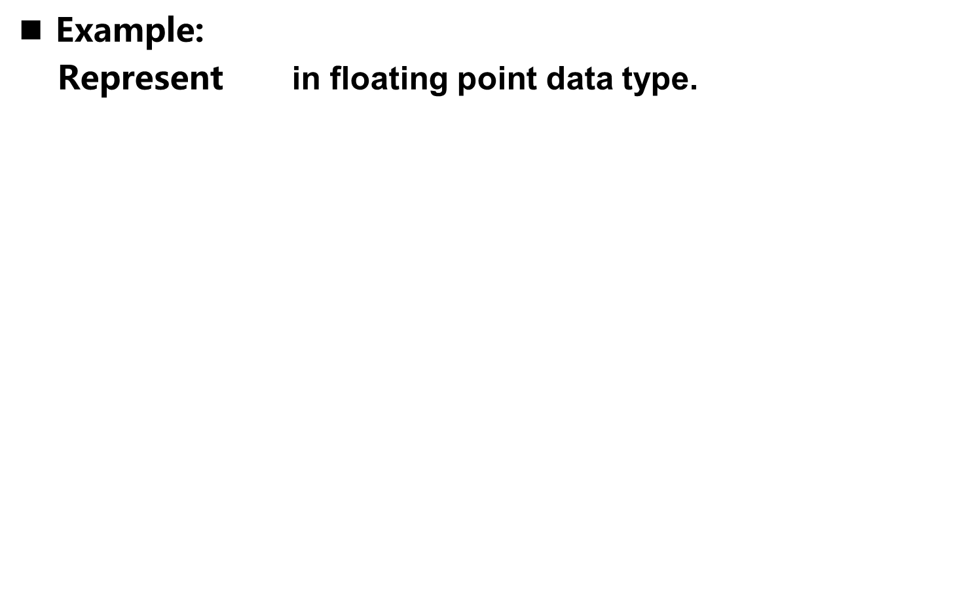
Floating Point Example
Example:
Represent in floating point data type.

Slide 20
Floating Point Example
6.625=（110.101)_{b}=1.10101×2²⁼ 1.10101 ×2¹²⁹⁻¹²⁷
Single-precision IEEE floating point number:
0 10000001 10101000000000000000000
  Sign is 0 – number is positive.
  Exponent field is 10000001 = 129 (decimal).
  Fraction is 0.101010000000… = 0.65625 (decimal).
Value = 6.625 = 1.65625 x 2² = 1.65625 x 2⁽¹²⁹⁻¹²⁷⁾.
sign
exponent
fraction

Slide 21
Floating-Point Operations
Will regular 2’s complement arithmetic work for
Floating Point numbers?
(Hint: In decimal, how do we compute 3.07 x 10¹² + 9.11 x 10⁸?)

Slide 22
Text: ASCII Characters
00 | nul | 10 | dle | 20 | sp | 30 | 0 | 40 | @ | 50 | P | 60 | ` | 70 | p
01 | soh | 11 | dc1 | 21 | ! | 31 | 1 | 41 | A | 51 | Q | 61 | a | 71 | q
02 | stx | 12 | dc2 | 22 | " | 32 | 2 | 42 | B | 52 | R | 62 | b | 72 | r
03 | etx | 13 | dc3 | 23 | # | 33 | 3 | 43 | C | 53 | S | 63 | c | 73 | s
04 | eot | 14 | dc4 | 24 | $ | 34 | 4 | 44 | D | 54 | T | 64 | d | 74 | t
05 | enq | 15 | nak | 25 | % | 35 | 5 | 45 | E | 55 | U | 65 | e | 75 | u
06 | ack | 16 | syn | 26 | & | 36 | 6 | 46 | F | 56 | V | 66 | f | 76 | v
07 | bel | 17 | etb | 27 | ' | 37 | 7 | 47 | G | 57 | W | 67 | g | 77 | w
08 | bs | 18 | can | 28 | ( | 38 | 8 | 48 | H | 58 | X | 68 | h | 78 | x
09 | ht | 19 | em | 29 | ) | 39 | 9 | 49 | I | 59 | Y | 69 | i | 79 | y
0a | nl | 1a | sub | 2a | * | 3a | : | 4a | J | 5a | Z | 6a | j | 7a | z
0b | vt | 1b | esc | 2b | + | 3b | ; | 4b | K | 5b | [ | 6b | k | 7b | {
0c | np | 1c | fs | 2c | , | 3c | < | 4c | L | 5c | \ | 6c | l | 7c | |
0d | cr | 1d | gs | 2d | - | 3d | = | 4d | M | 5d | ] | 6d | m | 7d | }
0e | so | 1e | rs | 2e | . | 3e | > | 4e | N | 5e | ^ | 6e | n | 7e | ~
0f | si | 1f | us | 2f | / | 3f | ? | 4f | O | 5f | _ | 6f | o | 7f | del
ASCII: Maps 128 characters to 7-bit code.
  both printable and non-printable (ESC, DEL, …) characters
Notes:
22

Slide 23
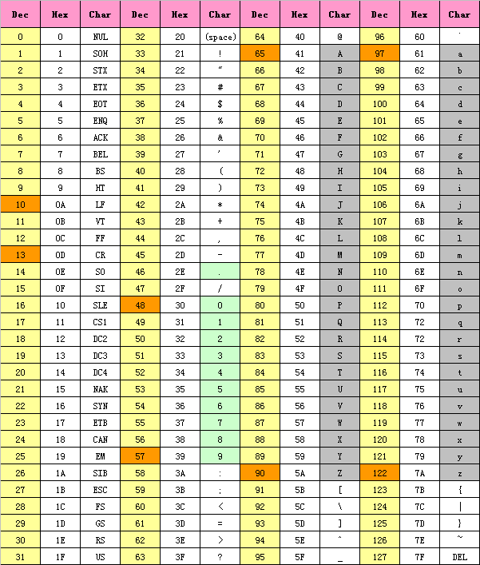
ASCII（American Standard Code for Information Interchange）

Slide 24
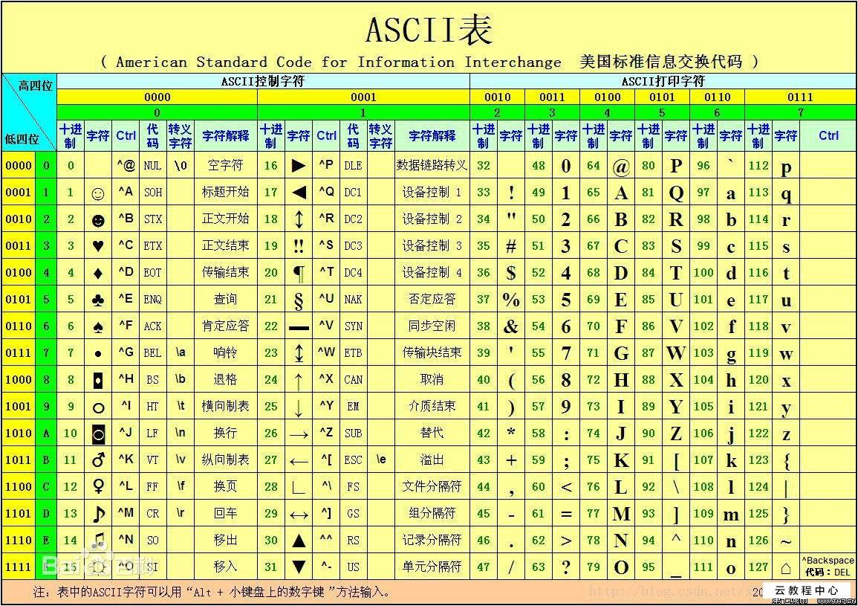
ASCII 码

Slide 25
Interesting Properties of ASCII Code
What is relationship between a decimal digit ('0', '1', …)
and its ASCII code?
What is the difference between an upper-case letter
('A', 'B', …) and its lower-case equivalent ('a', 'b', …)?
Given two ASCII characters, how do we tell which comes first in alphabetical order?
Are 128 characters enough?
(http://www.unicode.org/)
No new operations -- integer arithmetic and logic.

Slide 26
Other Data Types
Text strings
  sequence of characters, terminated with NULL (0)
  typically, no hardware support
Image
  array of pixels
    monochrome: one bit (1/0 = black/white)
    color: red, green, blue (RGB) components (e.g., 8 bits each)
    other properties: transparency
  hardware support:
    typically none, in general-purpose processors
    MMX -- multiple 8-bit operations on 32-bit word
Sound
  sequence of fixed-point numbers
Within the Computer: Everything is a Number.

Slide 27
LC-3 Data Types
Some data types are supported directly by the
instruction set architecture.
For LC-3, there is only one supported data type:
  16-bit 2’s complement signed integer
  Operations: ADD, AND, NOT
Other data types are supported by interpreting
16-bit values as logical, text, fixed-point, etc.,
in the software that we write.
Notes:
27

Slide 28
Summary
Everything in a computer is a number, in fact only 0 and 1.
Integers are interpreted by adhering to fixed length
Negative numbers are represented with Two’s complement
Overflows can be detected utilizing the carry bit
We will get into some more representations later when we talk about floating point
Sign Magnitude & Biased representations are needed in floating point for specific uses
Not going to talk about ‘1s complement’, its a joke that nobody uses

Slide 29
Assignments
2.4-2.6; 2.10-2.12;2.17; 2.20;2.24; 2.34; 2.37; 2.39; 2.43; 2.51; 2.54

